Slide 1
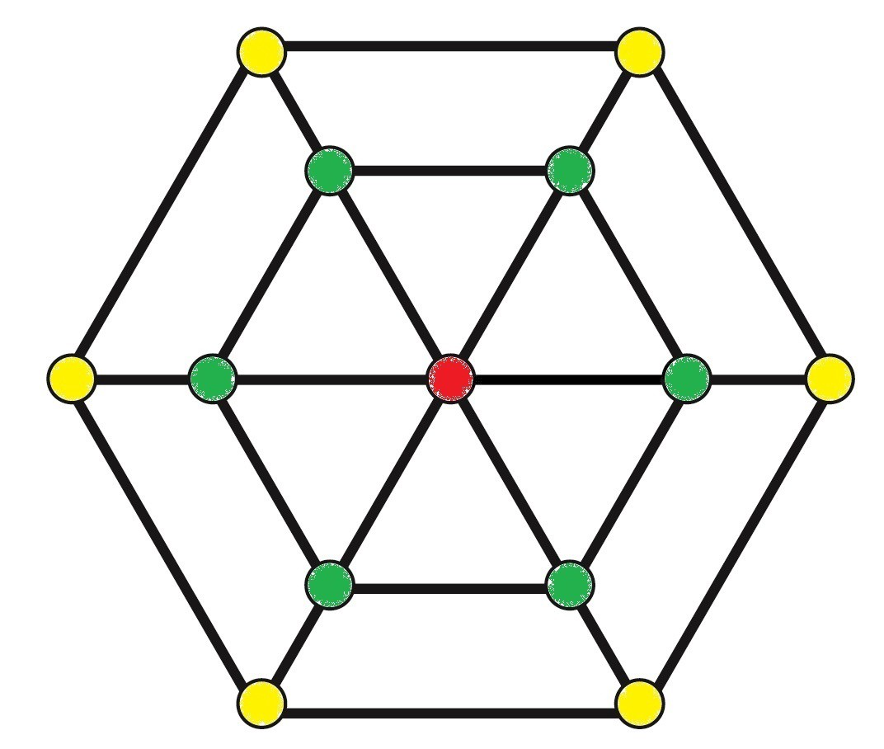
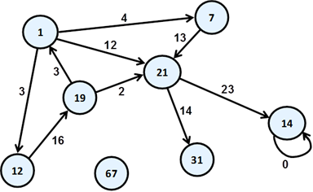
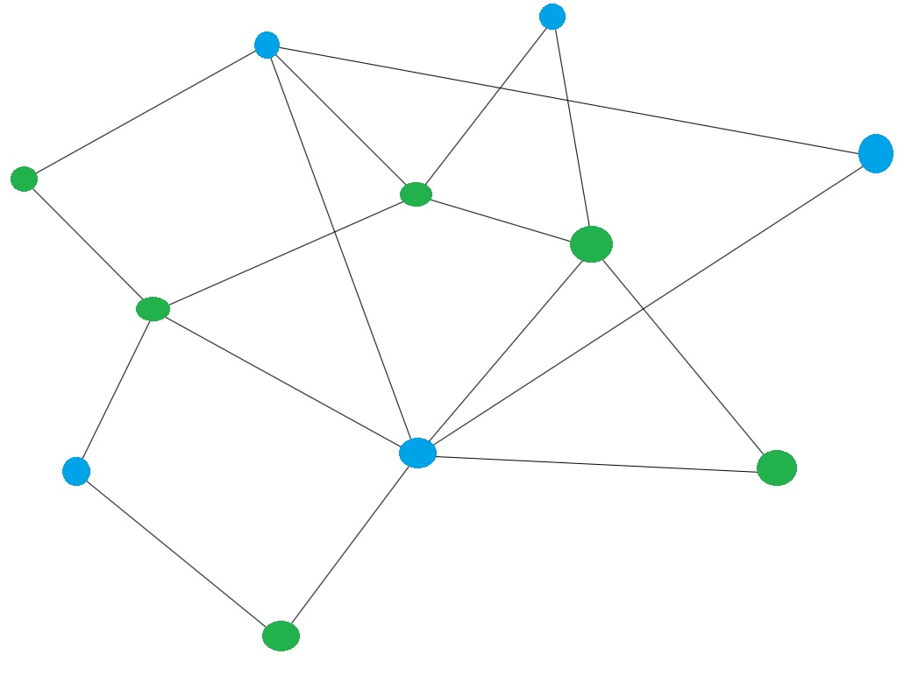
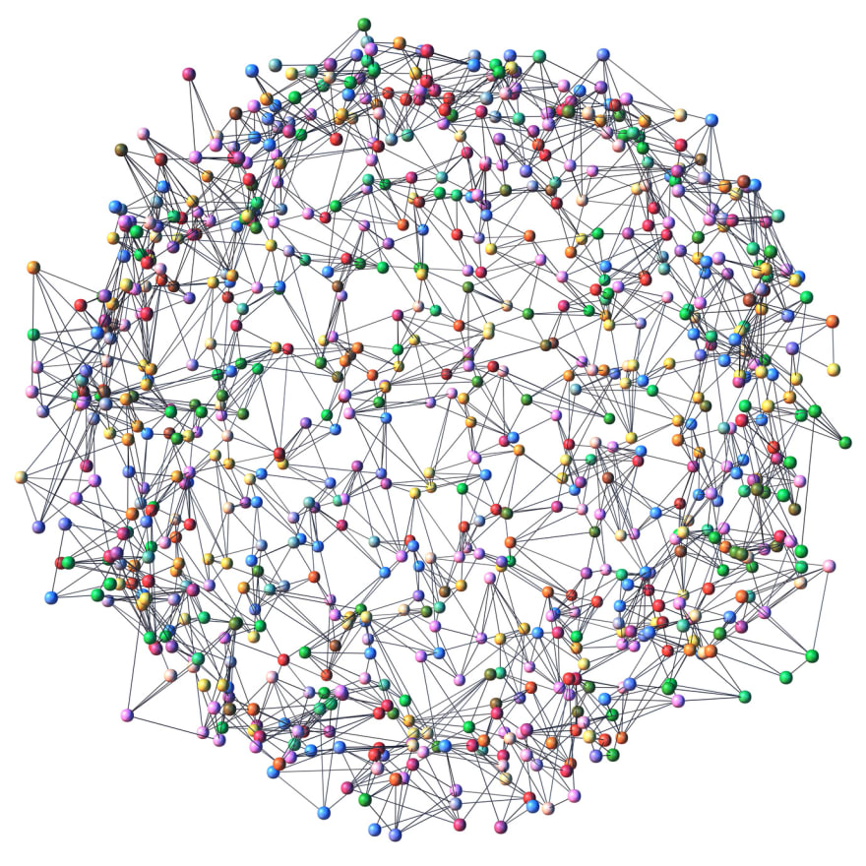
CSE 280 Discrete Mathematics
W. Clements
13.1 – 13.5
13.6-13.9
7.4

Slide 2
13.1 – 13.5
13.1 Introduction to graphs
13.2 Graph representations
13.3 Graph isomorphism
13.4 Walks, trails, circuits, paths, and cycles
13.5 Graph connectivity

Slide 3
13.6-13.9
13.6 Euler circuits and trails
13.7 Hamiltonian cycles and paths
13.8 Planar graphs
13.9 Graph coloring

Slide 4
7.4

Slide 5
Trees vs Graphs
Both are composed of vertices/nodes and edges/links.
Tree: A tree is an undirected graph that is connected and has no cycles. A tree is a type of graph.
Graph: Can have cycles (but doesn't have to). Does not have to be connected.
Graphic from: https://medium.com/swlh/making-data-trees-in-python-3a3ceb050cfd

Slide 6

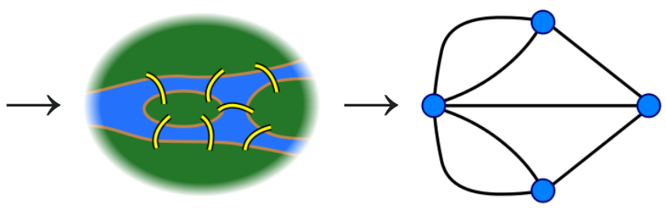
Applications of Graphs
Used to model relationships
Can represent any relation (recall reflexive, symmetric, antisymmetric, transitive)
Solve problems in many disciplines
Graph theory started when Euler solved the Seven Bridges of Konigsberg problem

Slide 7
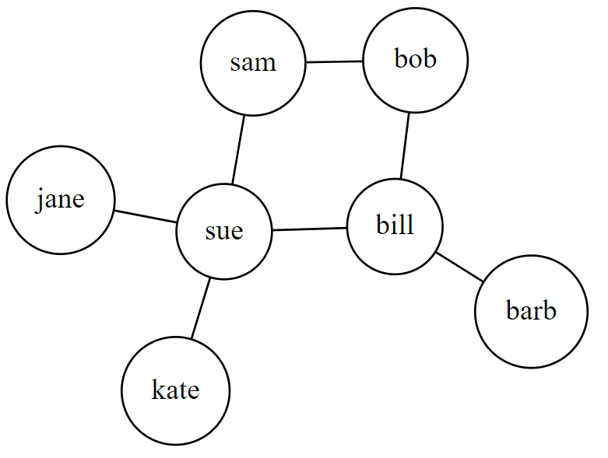
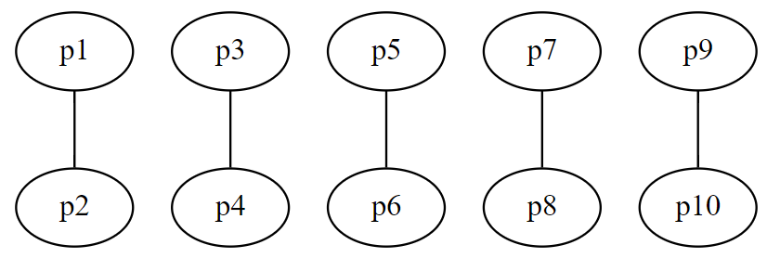
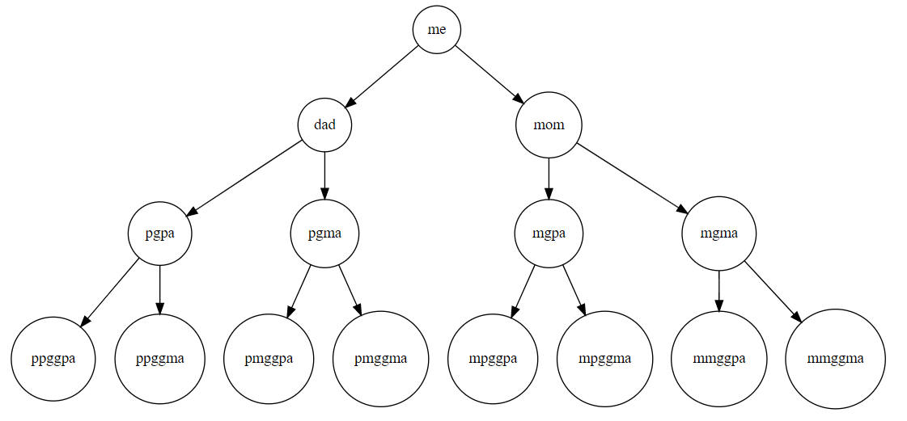
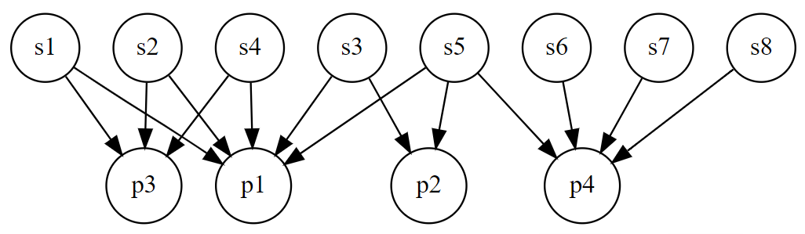
Applications of Graphs
Relationships between people
Friends in a social networking site
Marriages
Genealogical relationships
Students/Professors

Slide 8
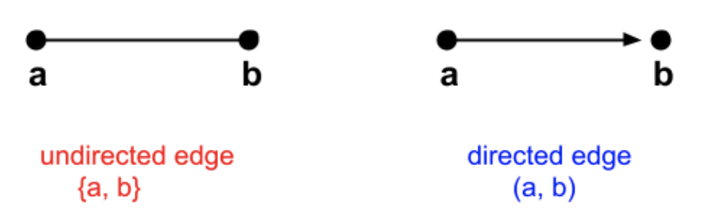
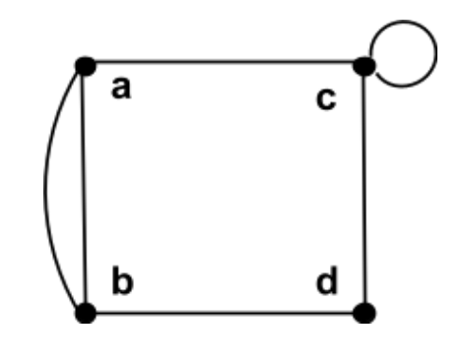
Terms
Undirected graph
Graph sets (V, E)
V – vertex set = {a, b, c, d, e}
E – edge sets – { {a,b}, {a,c}, …{e,e}} vs { (a,b), (a,c), … (e,e) }
Undirected vs Directed edge
Parallel edges vs self-loop
Adjacent
Endpoints
Neighbor
Degree
Total Degree
Regular Graph and d-regular graph
graph H = (V_{H}, E_{H}) is a subgraph of a graph G = (V_{G}, E_{G}) if V_{H} ⊆ V_{G} and E_{H} ⊆ E_{G}.

Slide 9
Applications of Graphs
Scheduling problems (example: How to fit the greatest number of classes into a given schedule)
Countries that share a border
What is the fewest number of distinct frequencies needed among 10 radio stations so there is no interference?
Track winners in a tournament
Roadmaps
Can a given electrical circuit be implemented on a planar circuit board?
Model computer networks
And on and on...

Slide 10
Homework Review
With a peer, review Homework 11

Slide 11
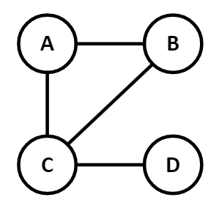
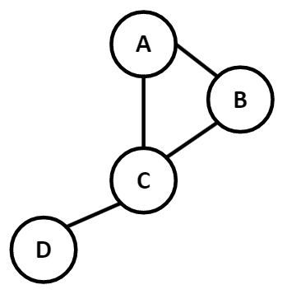

Simple Graph definition:
$G=(V,E)$ where $V$ is a nonempty set of vertices and $E$ (the edges) is a set of two-element sets (i.e., unordered pairs) of elements of $V$
Example:
$G=\left(\left\{A, B, C, D\right\}, \left\{\left\{A,B\right\}, \left\{A,C\right\}, \left\{B,C\right\}, \left\{C,D\right\}\right\}\right)$
A graph $G$ is an ordered pair consisting of a nonempty set of Vertices (Nodes) and a set of Edges (Links)
It can be helpful to draw it, but this is not necessary to be considered a graph
These both represent the same graph

Slide 12
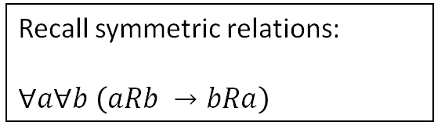
Recall symmetric relations:
$∀a∀b \left(aRb →bRa\right)$
Simple Graphs:
No self-loops. Only one edge between any two vertices.
Model symmetric relations
Edges are undirected (i.e., edges represent a symmetric relation)
Any pair of objects can be related or not related
We can use a simple graph to model anything with symmetric relations
Examples:
Countries that share a border or do not share a border
Land masses connected by a bridge
Cities connected by a road
Family relationships (marriage, sibling, cousin, etc)
People that speak the same language or don't speak the same language
Classes that are taught at the same time or not taught at the same time
...

Slide 13
Some Terms
Let G be an undirected graph and let k be an edge of G that is {u, v}.
u and v are adjacent
u and v are neighbors
u and v are connected
Edge k is incident with nodes u and v
Edge k connects u and v
Nodes u and v are the endpoints of edge k
U
k
V

Slide 14
More terms
Directed vs undirected
Node/vertex
Link/edge
Degree of a vertex
Total degree
Loop
Regular graph
D-regular graph
d
d
a
b
c
a
c
e
b
d
a
b
c
e

Slide 15
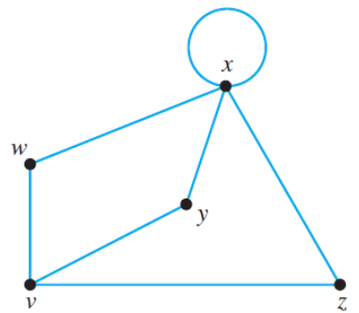
Degree Sequence
A sequence of the degrees of every node in a graph, listed in non-increasing order (highest to lowest)
Degree – number of edge on each vertice
What is the degree sequence of this graph?
[5,3,2,2,2]

Slide 16

Subgraphs
A graph $H=\left(V_{H}, E_{H}\right)$ is a subgraph of graph $G=(V_{G}, E_{G})$ if $V_{H}⊆V_{G}$ and $E_{H}⊆E_{G}$.
Is H a subset of G?
d
d
a
b
c
a
b
c
H
G
e

Slide 17

Subgraphs
A graph $H=\left(V_{H}, E_{H}\right)$ is a subgraph of graph $G=(V_{G}, E_{G})$ if $V_{H}⊆V_{G}$ and $E_{H}⊆E_{G}$.
What about now?
d
d
a
b
c
a
b
c
H
e
G
e

Slide 18
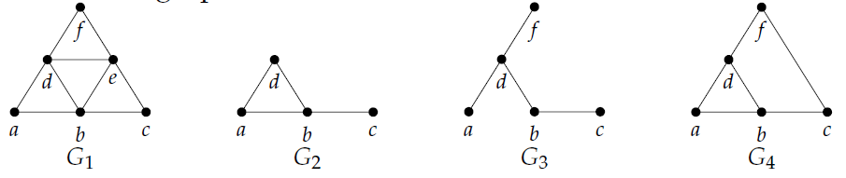



Subgraphs
Given a graph $G=(V, E)$, a subgraph of $G$ is any graph $H=(O, P)$ where $O⊆V$ and $P⊆E$.
Which of these are subgraphs of $G_{1}?$
$G_{2}$ and $G_{3}$ are both subgraphs of $G_{1}$.
$G_{4}$ is NOT a subgraph of $G_{1}$ because the link $\{c,f\}$ is not a link in $G_{1}$
Levin, Oscar. Discrete Mathematics, An Open Introduction, 3rd Edition. 2021

Slide 19
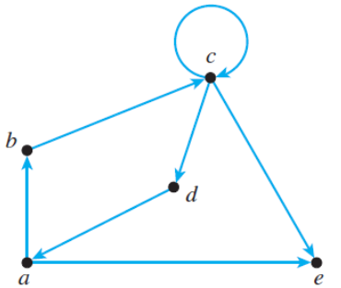

Directed Graphs (Digraphs)
Arbitrary binary relations (not necessarily symmetric)
Edges have direction. In other words, edges are ordered pairs.
$G = (V, E)$
$V = \{a,b,c,d,e\}$
$E= \{(a,b), (a,e), (b,c), (c,c), (c,d), (c,e), (d,a)\}$
Hunter, David J. Essentials of Discrete Mathematics, 3rd Edition. Jones & Bartlett Learning 2017

Slide 20
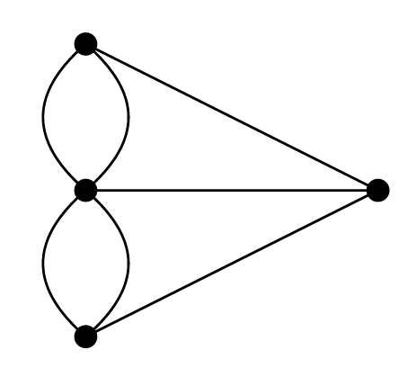
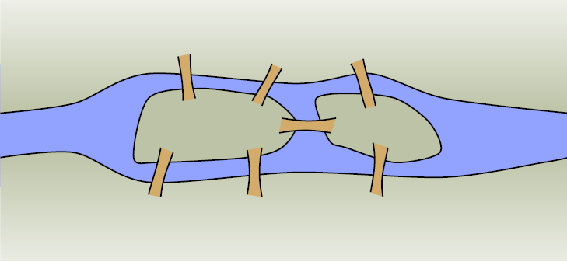
Multigraph
There may be more than one link between a pair of adjacent nodes

Slide 21
Pseudograph
One or more nodes is adjacent to itself (loops)

Slide 22

Complete Graph
Every pair of vertices is connected by an edge.
All possible edges are in the graph.
Every node in the graph is adjacent to every other node in the graph.
Denoted by $K_{n}$
Also called a clique of size n.

Slide 23

Handshaking Theorem
If we know the degrees of all the vertices in an undirected graph, we can find the number of edges.
Let $G=(V, E)$ be an undirected graph. Then,
$$\sum_{v∈V}{\deg\left(v\right)=2⋅\left|E\right|}$$
The sum of the degrees of each vertex is twice the number of edges
Think about it this way:
Each edge must have two vertices. Therefore, the sum of the degrees of the vertices is twice the number of edges.

Slide 24
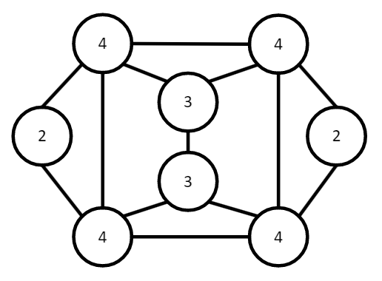



Handshaking Theorem
$$\sum_{v∈V}{\deg\left(v\right)=2⋅\left|E\right|}$$
Example:
How many edges are in the graph with the following degree sequence?
$[4,4,4,4,3,3,2,2]$
$$4+4+4+4+3+3+2+2=26$$
$\frac{26}{2}=13$ edges
Count them. Is it true?

Slide 25



Handshaking Theorem
$$\sum_{v∈V}{\deg\left(v\right)=2⋅\left|E\right|}$$
Example:
Is it possible for 7 people in a room to each shake hands with exactly 5 other people?
Turn it into a graph problem.
There are 7 vertices representing the 7 people. An edge between vertices represents a handshake. If each person shakes hands with exactly 5 other people, then each vertex has a degree of 5.
The sum of the degrees is
$5+5+5+5+5+5+5=7∗5= 35$
That would mean there are $\frac{35}{2}=17.5$ edges. That is not possible.

Slide 26

Handshaking Theorem
$$\sum_{v∈V}{\deg\left(v\right)=2⋅\left|E\right|}$$
Try it:
Among a group of 5 people, is it possible for everyone to be friends with exactly 2 of the people in the group?
What about with exactly 3 of the people in the group?
Yes. Using a graph of 5 vertices, there are 2 edges per vertex.
There are $\frac{2∗5}{2}=5$ edges. It is possible.
No. There are $\frac{5∗3}{2}=7.5$ edges. This is not possible.
Levin, Oscar. Discrete Mathematics, An Open Introduction, 3rd Edition. 2021

Slide 27
Additional Exercises
13.1.1
13.1.3

Slide 28
Adjacency List
Represents the relationship between vertices
s | a, b
a | g,c,d
b | d
g | e
c | e
d | f
e | t
f | t
t

Slide 29
Adjacency Matrix
Represent the relationship between nodes
 | S | A | B | C | D | E | F | G | T
S |  | 1 | 1
A |  |  |  | 1 | 1 |  |  | 1
B |  |  |  |  | 1
C |  |  |  |  |  | 1
D |  |  |  |  |  |  | 1
E |  |  |  |  |  |  |  |  | 1
F |  |  |  |  |  |  |  |  | 1
G |  |  |  |  |  | 1
T

Slide 30
Try It
Create an adjacency matrix for this graph

Slide 31
Additional Exercises
13.2.1
13.2.2
13.2.3 (if time)

Slide 32
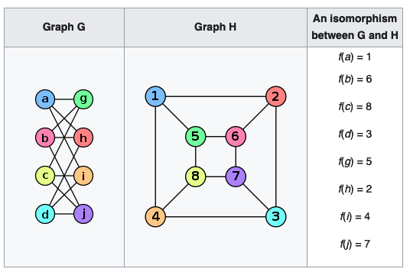

Graph Isomorphisms
Two graphs $G_{1}$ and $G_{2}$ are isomorphic if we can find a way to map the vertex sets of each graph such that there is an edge between two vertices in $G_{1}$ if and only if there is an edge between the corresponding two vertices in $G_{2}$.
In other words, we need to find a bijection function $f:V_{1}→V_{2}$ such that for every $x,y∈V_{1}$, then $\left\{x,y\right\}∈E_{1}$ if and only if $\left\{f\left(x\right), f\left(y\right)\right\}∈E_{2}$.
$f$ is an isomorphism from $G_{1}$ to $G_{2}$.

Slide 33
Graph Isomorphisms
Some graph properties are preserved under isomorphism.
If two graphs are isomorphic, then both have the same property.
Examples:
Vertex degree
Degree sequence
Anything related to the structure of the graph rather than the labels on the vertices/edges.

Slide 34
Additional Exercises:
13.3.1
13.3.2

Slide 35
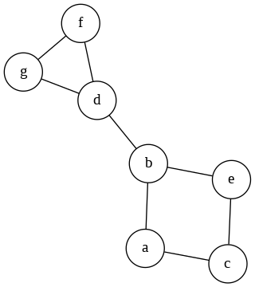
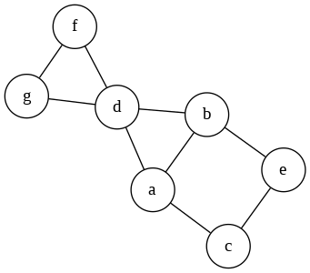
Graph Connectivity
k-vertex connectivity: The minimum number of vertices to remove so the graph is no longer connected.
k-edge connectivity: The minimum number of edges to remove so the graph is no longer connected.
What is the vertex connectivity and edge connectivity of these graphs?
1-vertex connected
1-edge connected
1-vertex connected
2-edge connected

Slide 36
Graph Connectivity
Additional exercises:
13.5.2

Slide 37
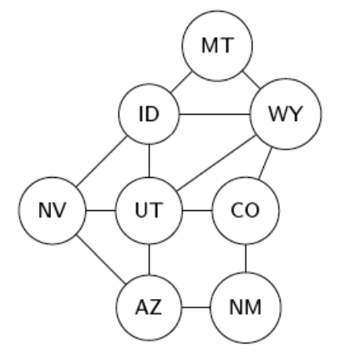
Walks
Graphs are made up of:
Vertices: ID, MT, WY, etc.
Edges: (ID,MT), (NV,ID), etc.
We represent a walk, trail, or path as a sequence of edges or as a sequence of vertices.
A trail is a sequence in which no edge occurs more than once.
A circuit is a closed sequence in which no edge occurs more than once.
A path is a trail that does not repeat vertices (which also means it does not repeat edges).
A cycle is a circuit in which no vertices are repeated, except the starting/ending vertex
Example:
A path from NV to WY:
As a sequence of Vertices: [NV, UT, WY]
As a sequence of Edges: [(NV,UT), (UT,WY)]

Slide 38
Circuit vs Cycle
A circuit is a trail from a vertex back to itself, with no repeated edges.
[(NV, ID), (ID, MT), (MT, WY), (WY, ID), (ID, UT), (UT, AZ), (AZ, NV)]
[NV, ID, MT, WY, ID, UT, AZ, NV]
A cycle is a path from a vertex back to itself, with no repeated vertices.
[(ID, MT), (MT, WY), (WY, CO), (CO, UT), (UT, AZ), (AZ, NV), (NV, ID)]
[ID, MT, WY, CO, UT, AZ, NV, ID]

Slide 39
A cycle is a path from a vertex back to itself
In other words, a cycle starts and stops at the same vertex, with no repeated vertices and no repeated edges.
[(ID, MT), (MT, WY), (WY, CO), (CO, UT), (UT, AZ), (AZ, NV), (NV, ID)]
[ID, MT, WY, CO, UT, AZ, NV, ID]

Slide 40
Some terminology
Directed vs undirected
Node/vertex
Link/edge
Degree of a vertex
Indegree
Outdegree
Path
Circuit / Cycle
Connected
Loop
Hunter, David J. Essentials of Discrete Mathematics, 3rd Edition. Jones & Bartlett Learning 2017

